Slide 1
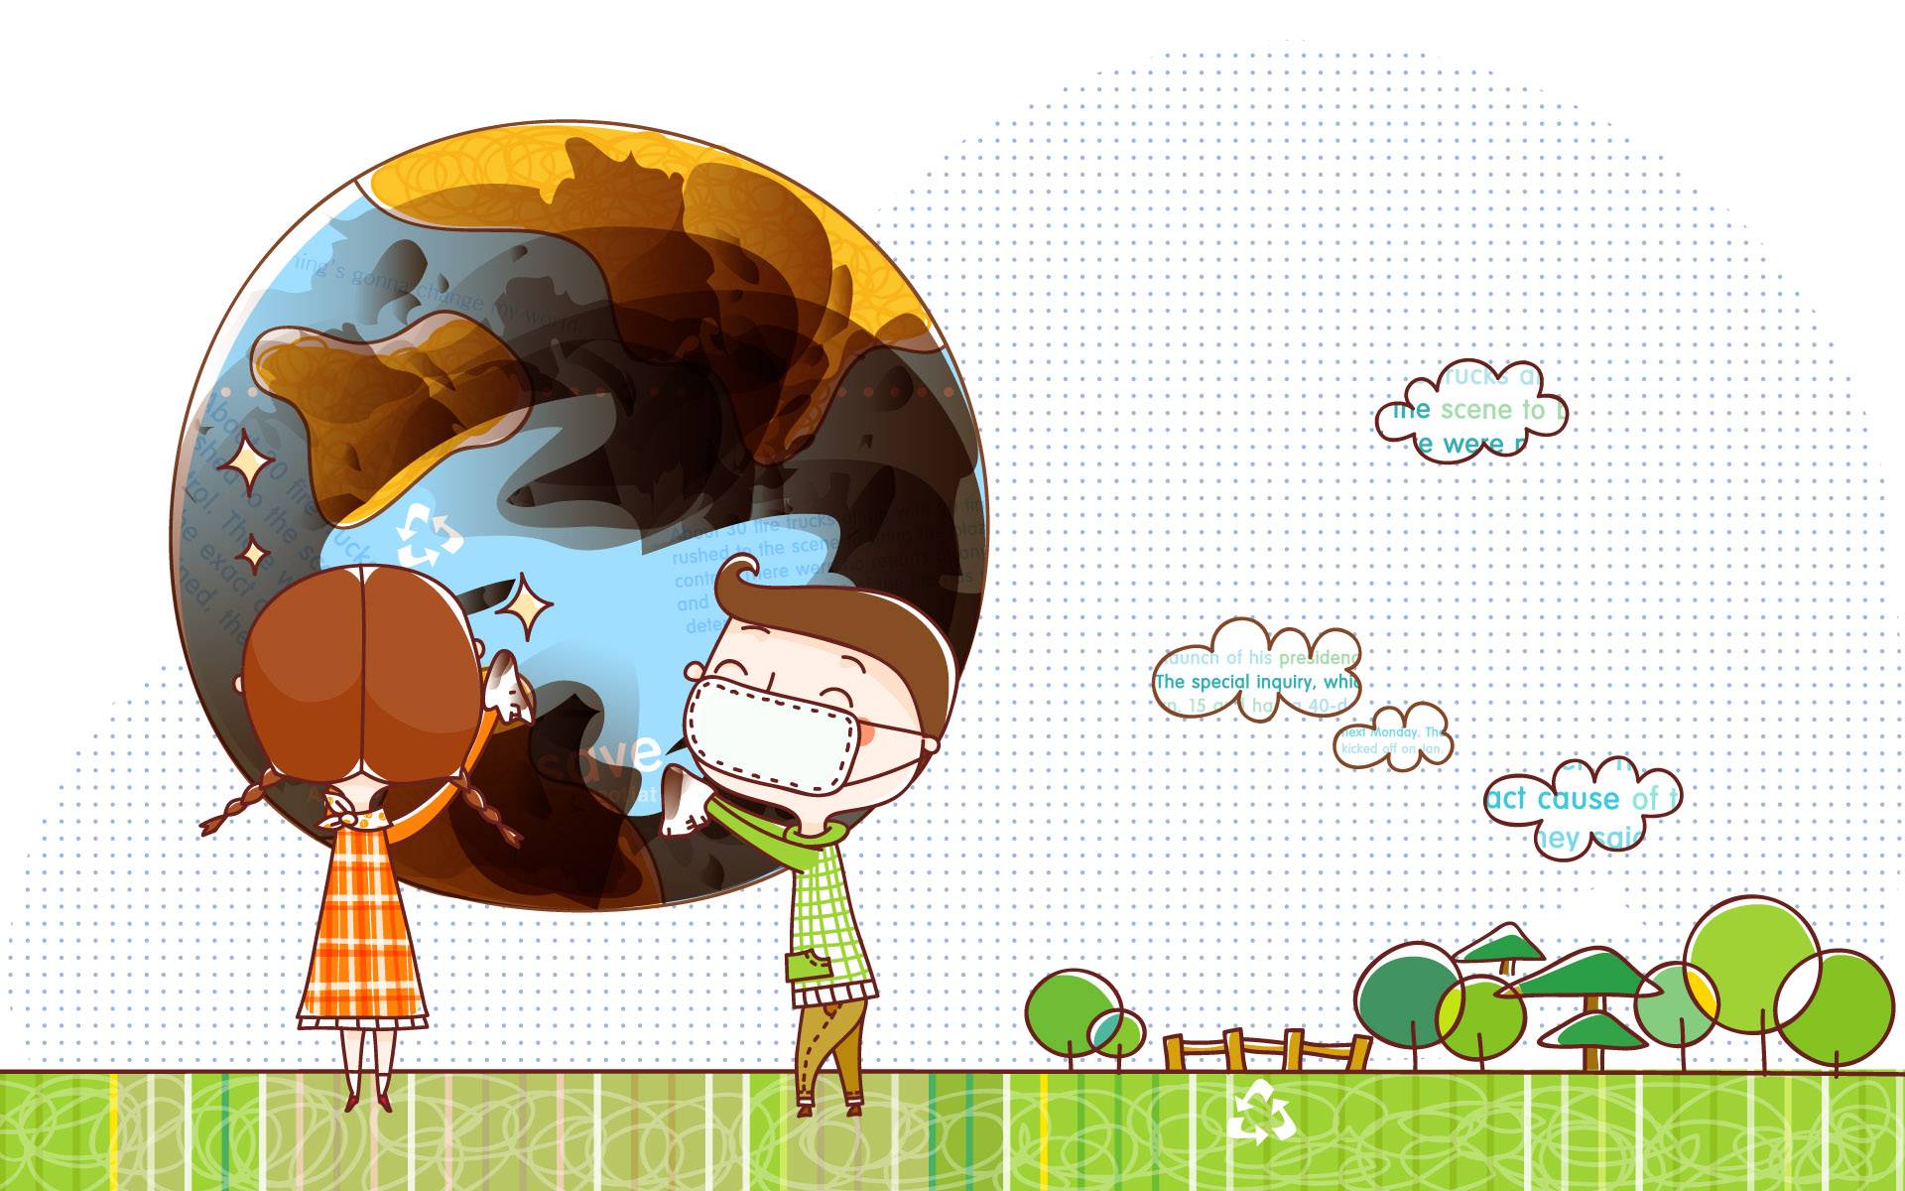

Slide 2
decode NUMBERs TO LETTERS
1 a
2 B
3 C
…

Slide 3
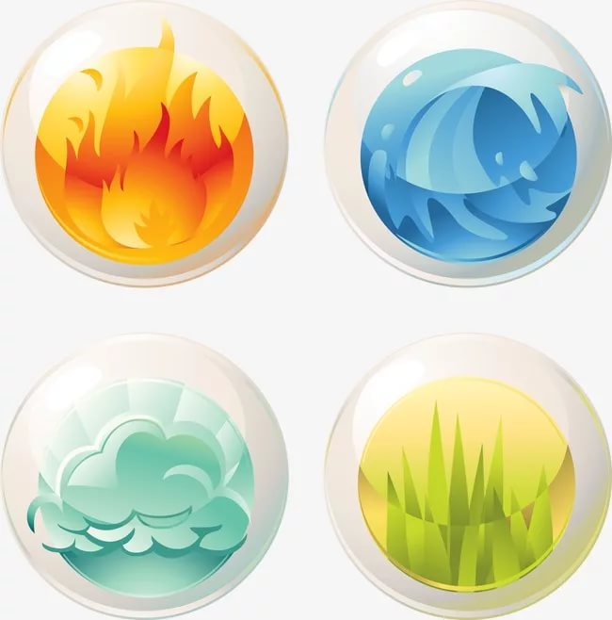
ENVIRONMENT
=
ECOLOGY

Slide 4
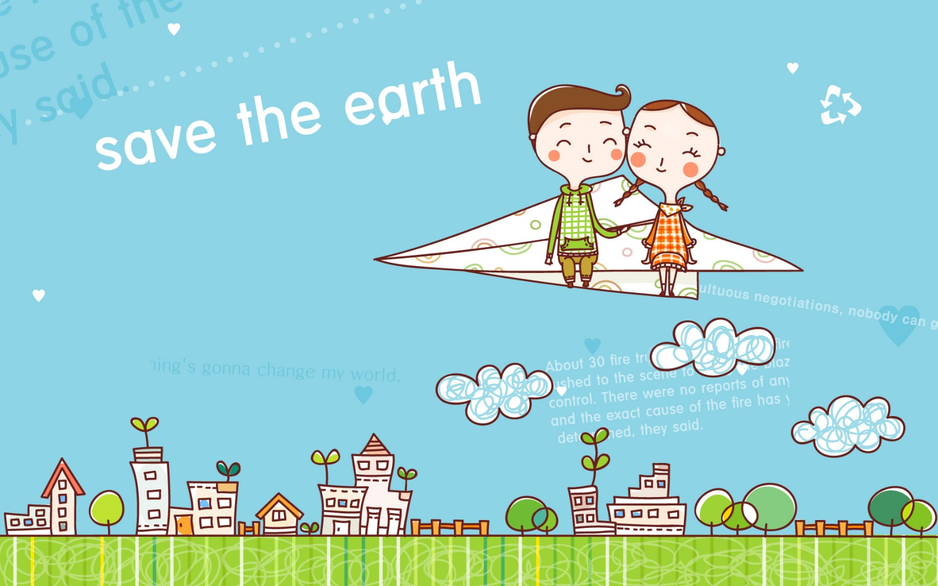
ECO HELPERS

Slide 5
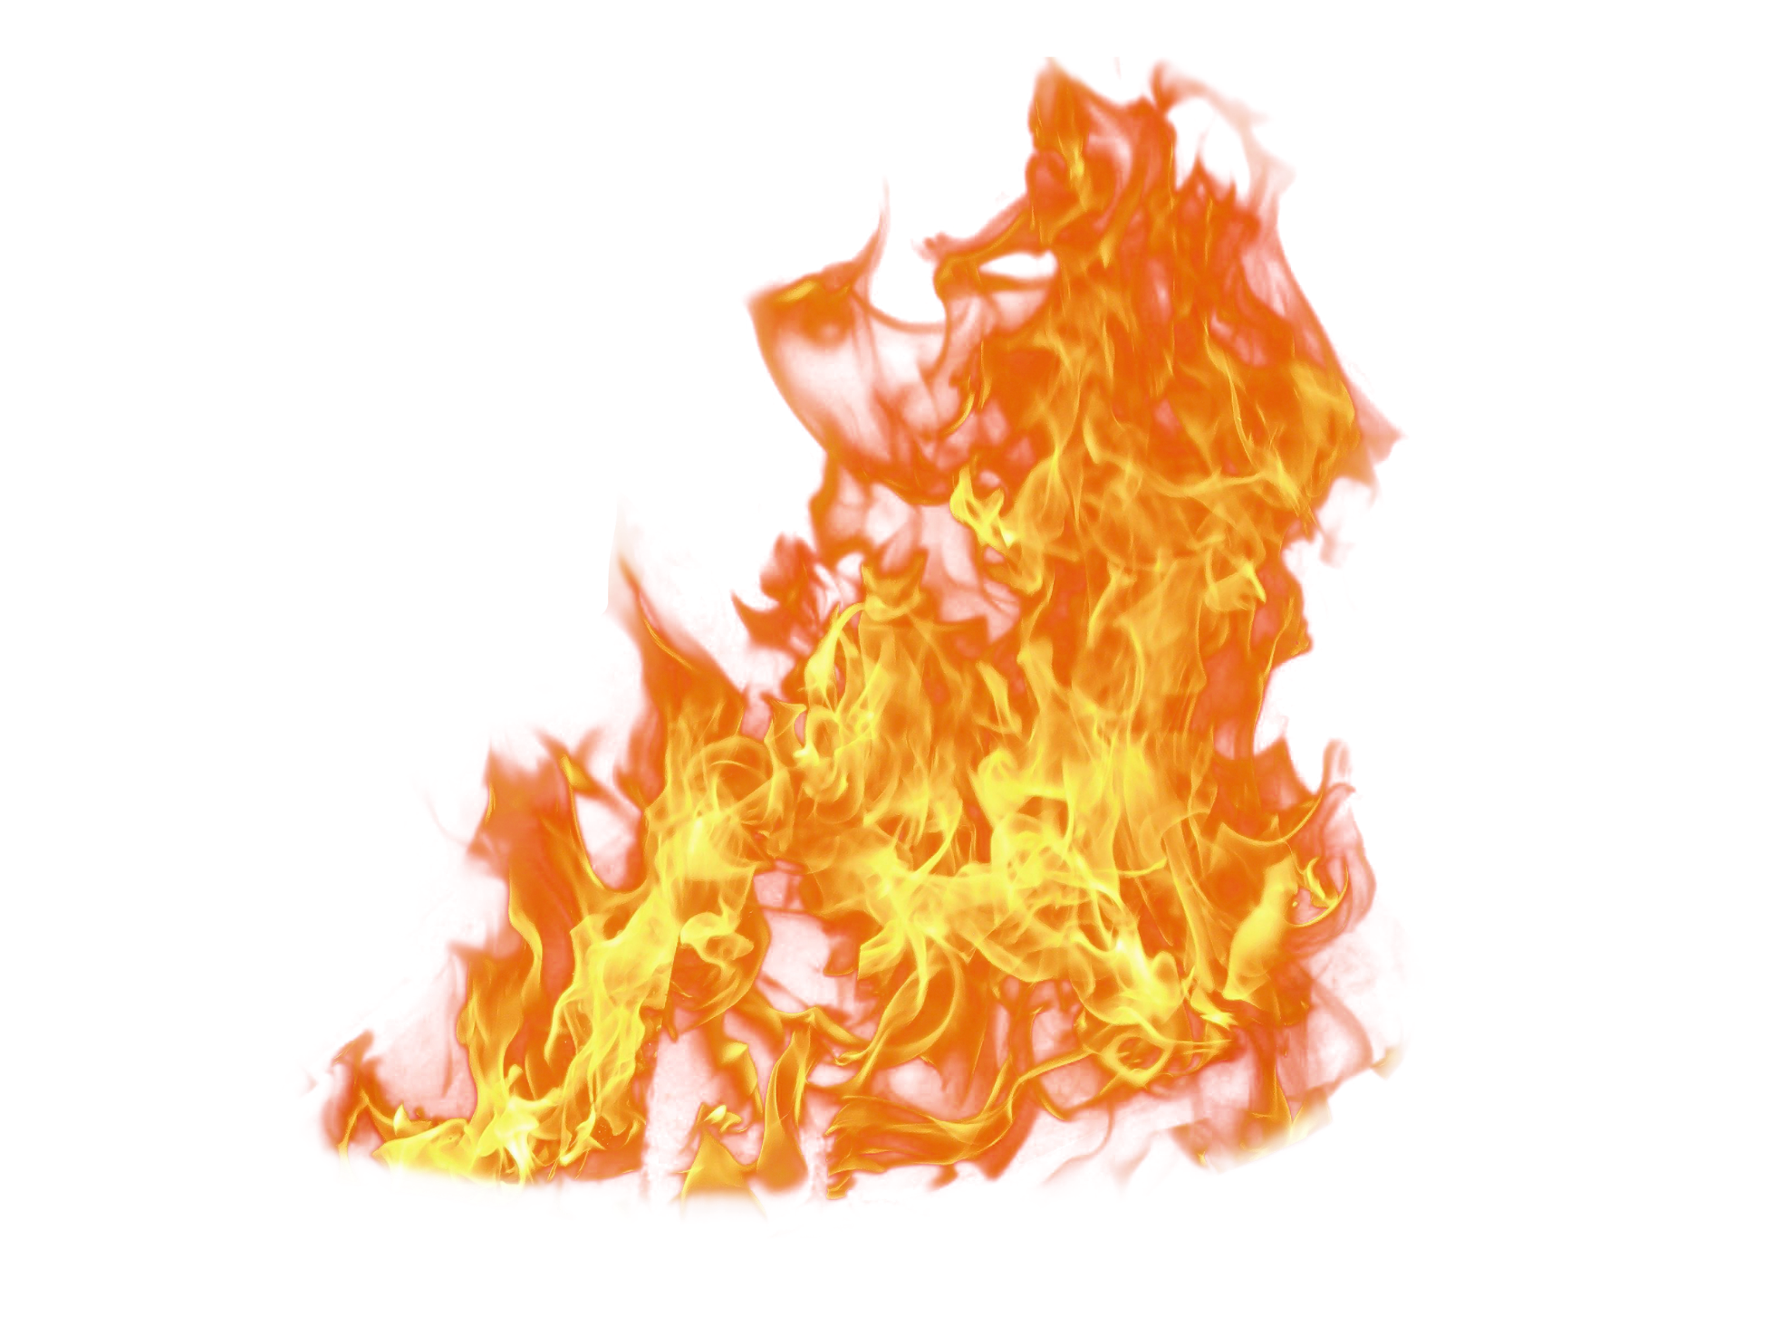
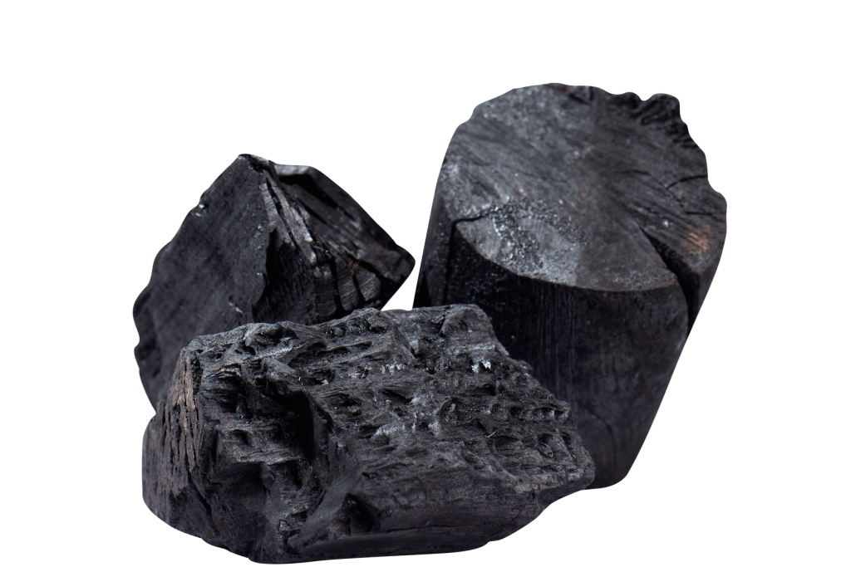
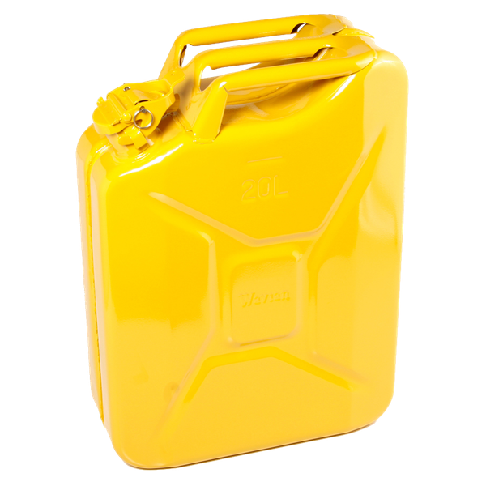
To burn coal and petrol

Slide 6
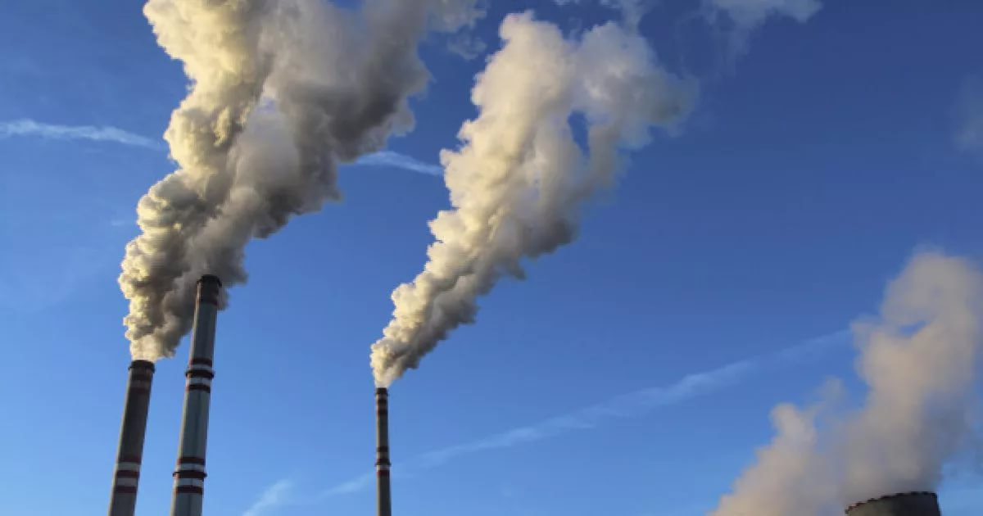
To emit toxic fumes

Slide 7
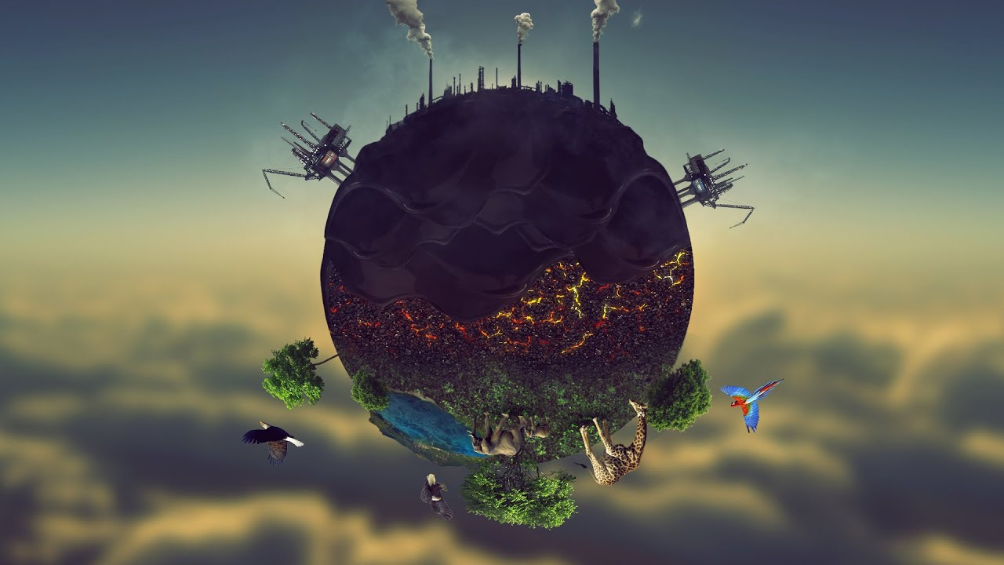
Pollution

Slide 8
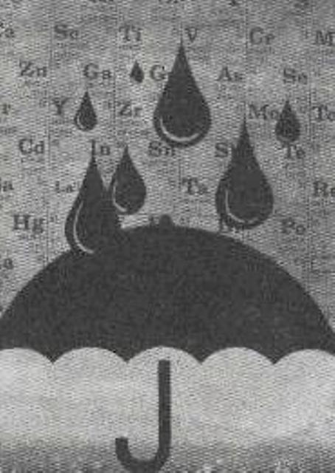
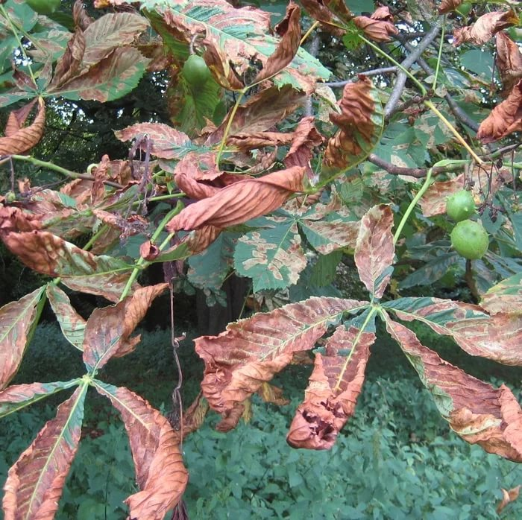
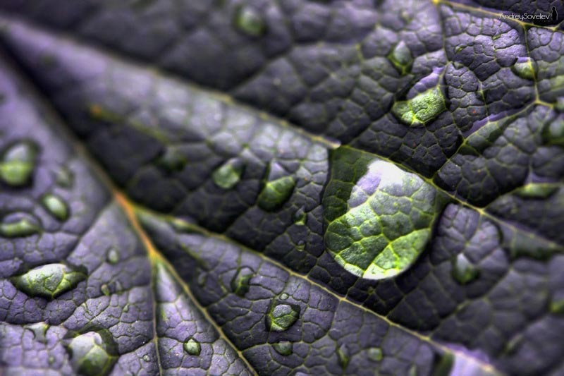
Acid rain

Slide 9
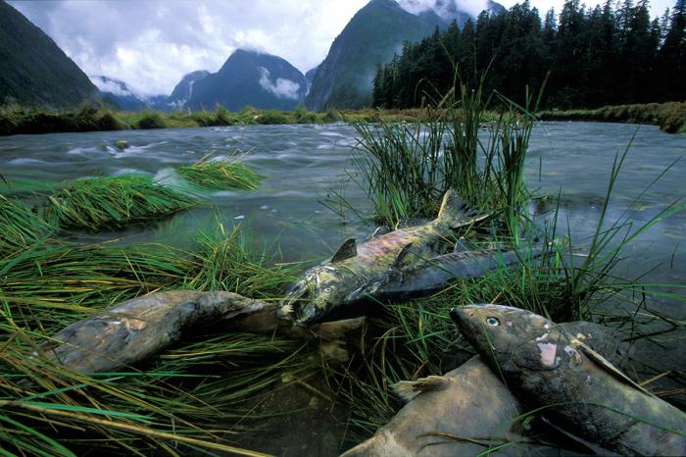
To wipe out fish, plants and animals

Slide 10

To poison

Slide 11

To reduce

Slide 12

THE EARTH IS IN DANGER
What causes to serious damages?
The problems start here. Cars burn petrol, factories and power stations burn coal and emit toxic fumes. So, the air that we breathe becomes polluted.
This pollution gathered in clouds and with the oxygen and water in the atmosphere it becomes acid. The wind carry the polluted clouds across long distances, far away. When it rains, this pollution lands on trees, houses, buildings, cars, clothes, everywhere! This is called acid rain.
When acid rain falls into lakes, streams, rivers and seas they become toxic. This is water pollution and it harms, kills or wipes out fish and plant species.
When acid rain flows through the soil, it poisons trees and plants. Acid rain also causes serious damage to important buildings and objects.
The good news is that government have been trying to reduce the air, water and soil pollution that causes acid rain.
But we need to do more!!!

Slide 13
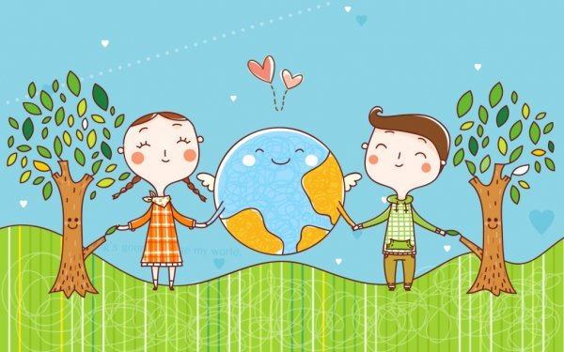
Good luck

